Slide 1
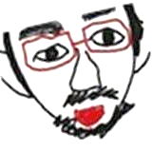
Ⅰ ａｍ Ｄｅａｆ,
ａｎｄ ｐｏｏｒ ａｔ Ｅｎｇｌｉｓｈ.
However, I would like to communicate with
Friends of Ｔｅａｍ４４.
Ｗｅ ｏｖｅｒｃｏｍｅ
ｔｈｉｓ ｃｈａｌｌｅｎｇｅ!

Slide 2
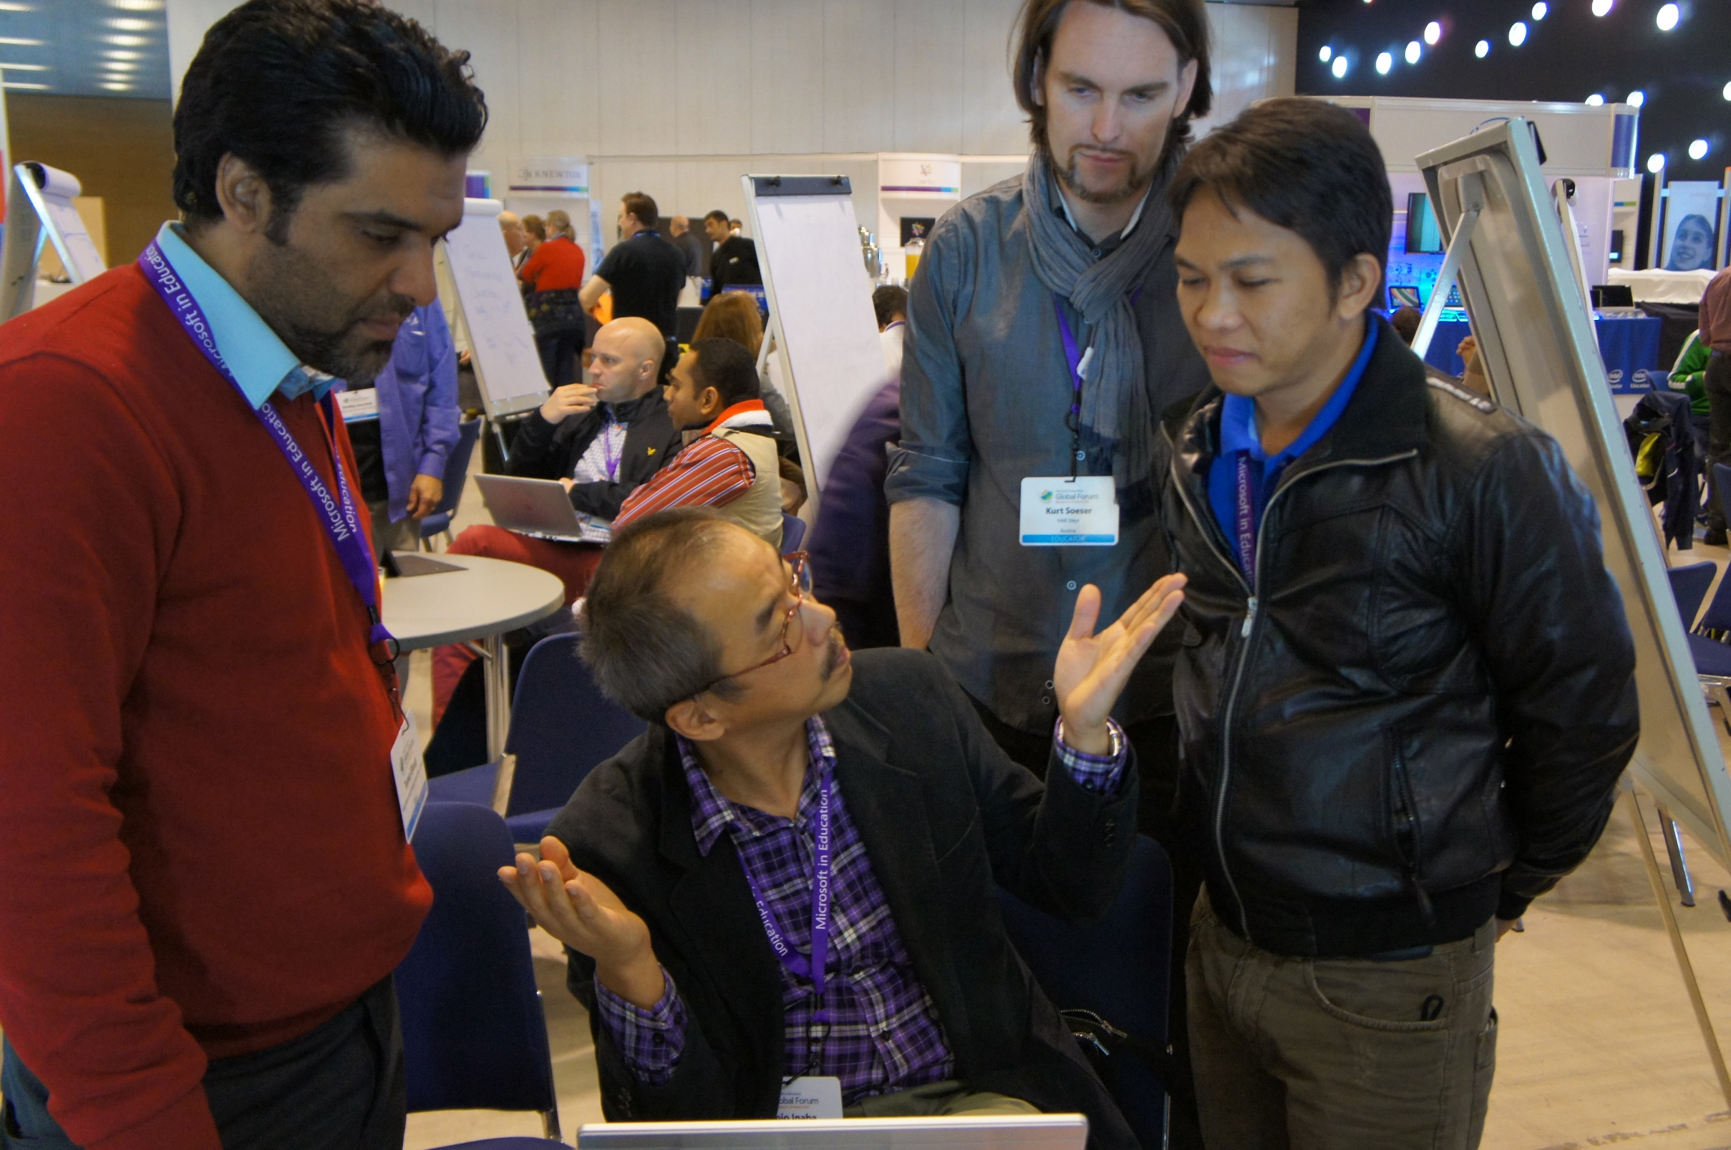
ＴＥＡＭ 44

Slide 3
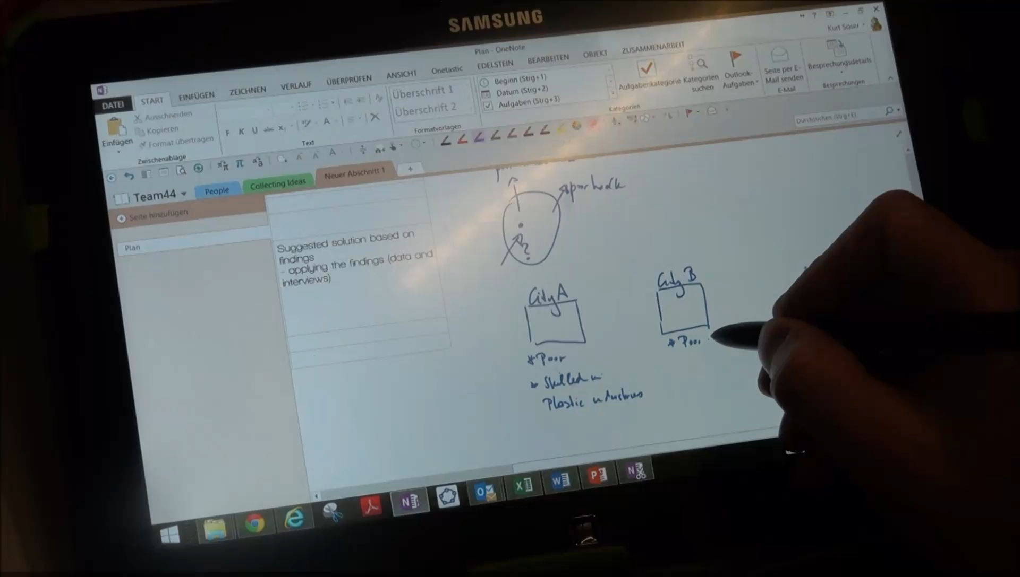
Ｗｅ ｃｏｌｌａｂｏｒａｔｅｄ !
Microsoft OneNote

Slide 4
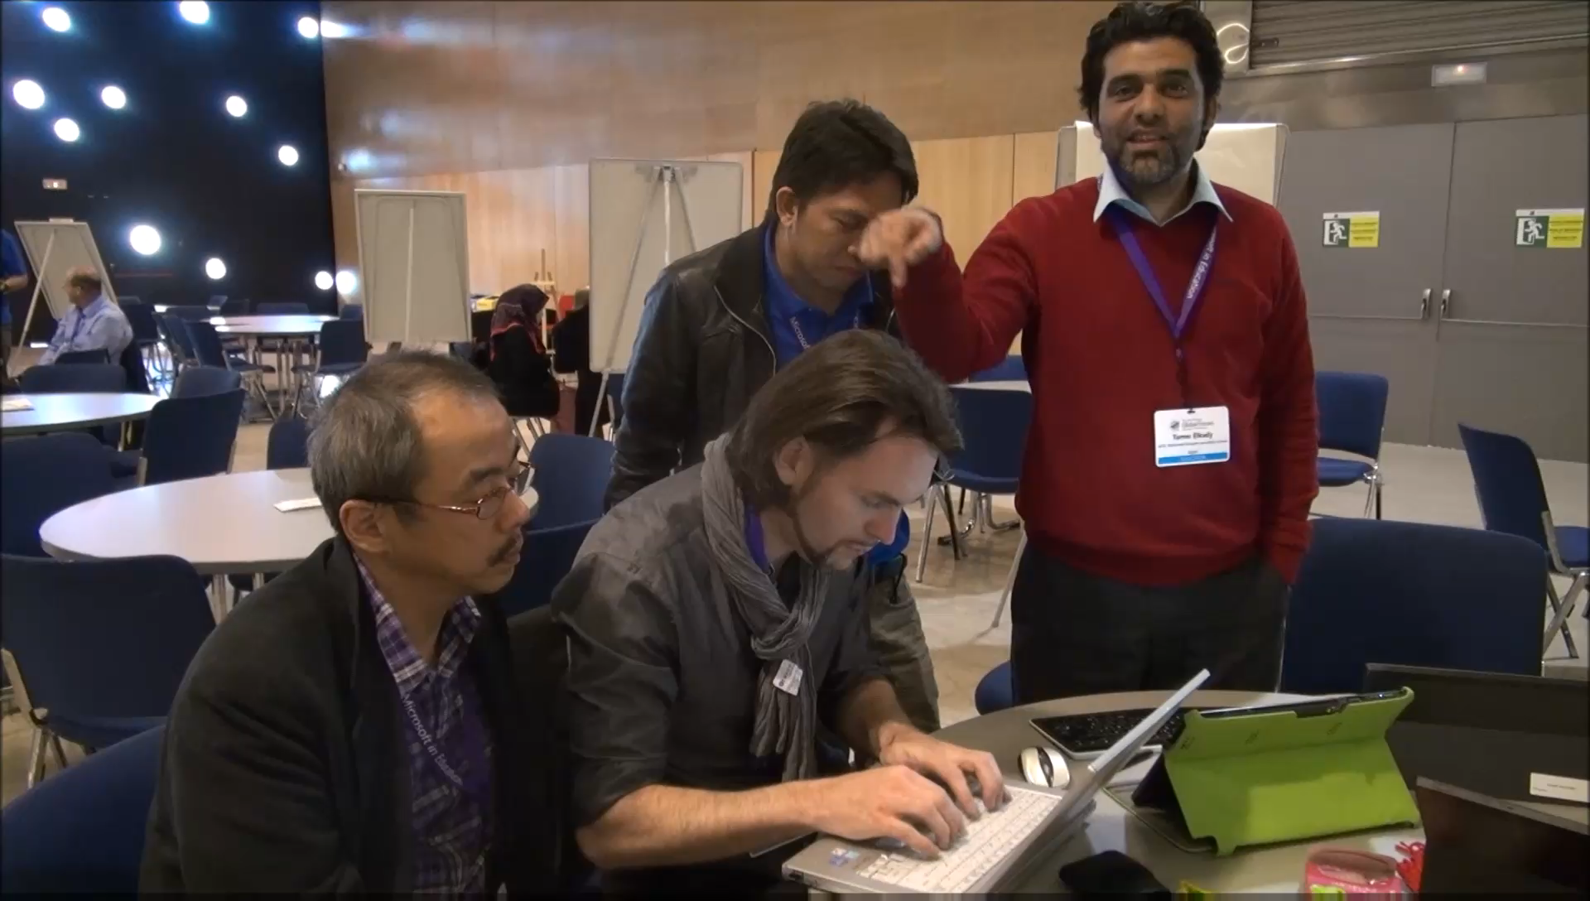
Ｗｅ ｃｏｌｌａｂｏｒａｔｅｄ !
Japanese ⇔ English Translation

Slide 5
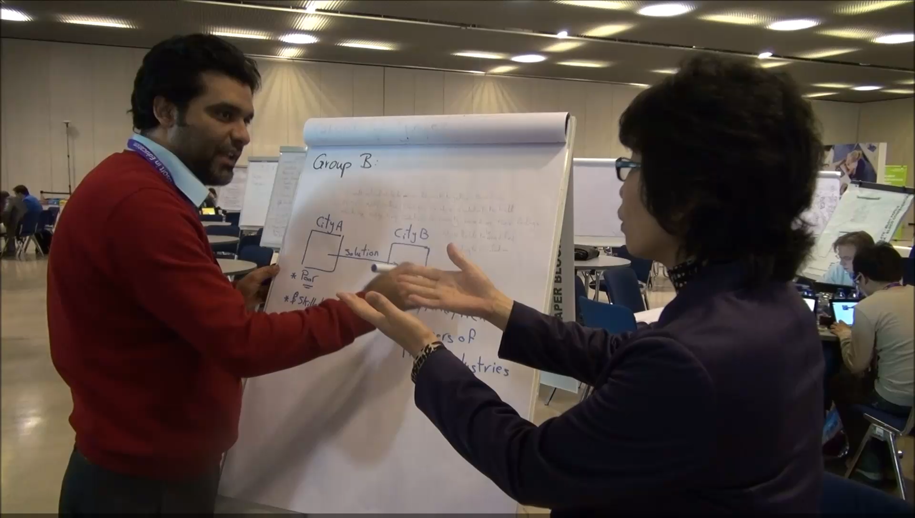
Ｗｅ ｃｏｌｌａｂｏｒａｔｅｄ !
Writing

Slide 6
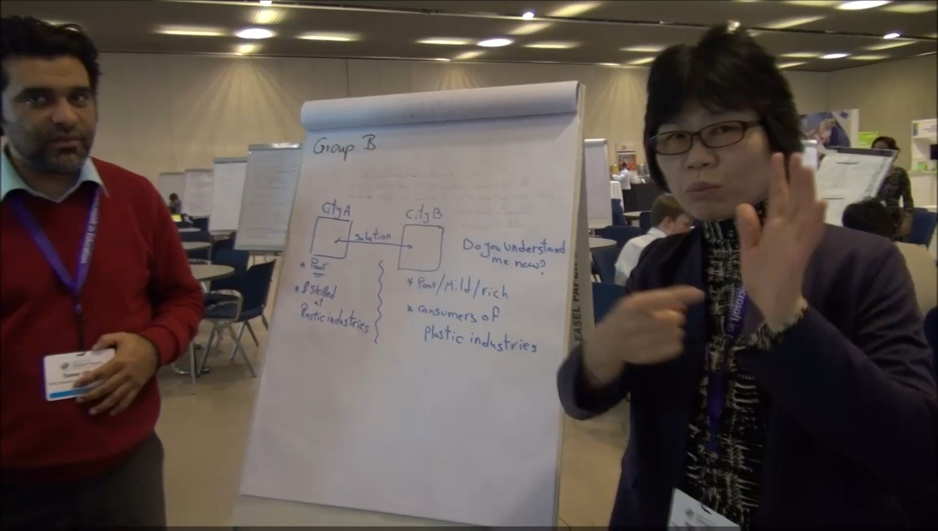
Ｗｅ ｃｏｌｌａｂｏｒａｔｅｄ !
Sign Language interpreting

Slide 7

We enjoy Diversity！
ちがうことこそ、ばんざい！
Everyone is unique
that is the value.
Thank you very much
for your kind attention！

