Slide 1
Poverty: Causes and Solutions
Michio Inaba (JAPAN), Tamer El Kady (EGYPT), Ernani Fernandez (PHILIPPINES), Kurt Söser (AUSTRIA)

Slide 2
Identifying the cause of local poverty and find solutionS
Objective

Slide 3
Brief Discription
The learning activity requires the students to work with students from other countries concerning poverty based on ADDIE-Model (Analyze, Design, Develop, Implemenation, Evaluation). The goal is to give recommendations to people in charge to eradicate gradually the poverty. It is about students building skills in a collaborational environment. They have to use and apply these skills to find out the causes of local poverty, building knowledge and suggesting solutions based on their findings.

Slide 4
Overview
Orientation
Building groups
Group work/collaboration
Exchange
Problem solving
Evaluation
Notes:
Thank you to my deaf friend Michio!
Here is a quick overview of the steps laid out for our Learning Activity

Slide 5
Orientation
Notes:
In a first orientation phase we will meet online and give the basic infos about the learning activity to our students! We set the goals and aims and try to get them together!

Slide 6
Building groups
Notes:
In the next the step our students will be building groups with members of each our country and set up the group rules.

Slide 7
Groups
data miners
interviewers
marketers
Notes:
There are three working groups ant they will be now presented by my friend Ernani

Slide 8
Data Miners
collect and visualize
interpret data
produce reports

Slide 9
Interviewers
contact people
interview
produce video

Slide 10
marketers
blog
documentation
global awareness

Slide 11
Data miners
Interviewers
Marketers
Problem solvers
Problem solvers
Problem solvers
Exchange
Notes:
After our students have built up their skills, it is time to exchange! From every group a member joins to the – as we called it – “problem solvers”. So in every problem solver group there are

Slide 12
Problem Solvers
Finding cause
Suggesting solutions

Slide 14
evaluation
Notes:
After this process we will get our students back into the first three groups and engage them to to a evaluation of the whole process!
The last “word” will have Michio again

Slide 15
There are many poverty problems, complaints, etc. also among Japan. Students have to solve it.
For that purpose, probably, the student needs to have various powers and we have to empower them.
One of them is practical use of ICT. It needs to be actively considered by the student itself.
Disabled persons, Let's change society!
For a disabled person's students, I did my best in communication with the friend of Team44, and collaboration.

Slide 16
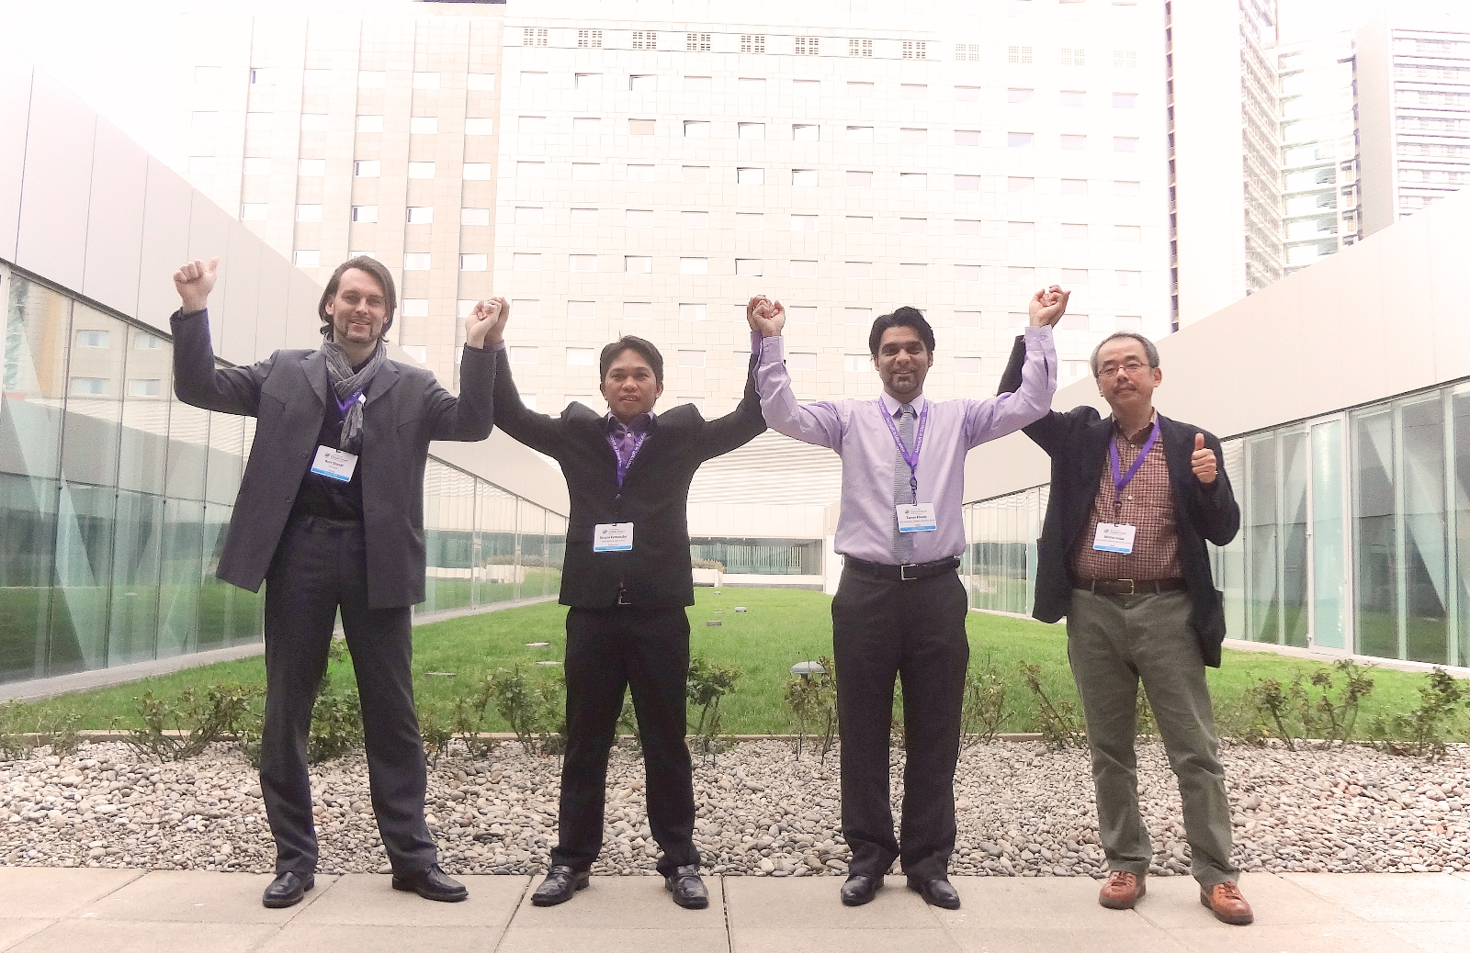

Slide 17
Data miners
Target | Collect and visualize data of "national" and "local" poverty
Technology used | Bing MS Office (Excel) Office online (setting up a survey) any other applicable ICT tool
Procedure | Collect data from the Internet about poverty in the 4 different countries (time aspect, percentages, etc.) Visualize this data (maps, diagrams…) Interpret the data Produce reports.
Roles | Researcher, Documenter, Quality manager
Final product | Report on interpretation and visualization of data

Slide 18
interviewers
Target | Interview "poor" and "rich" people
Technology used | cameras smartphones movie maker
Procedure | Find and contact people who are willing to be interviewed Formulate and design interview questions Videorecord the interview Edit the interview (cut, transcript)
Roles | Researcher, Documenter, Quality manager
Final product | Short video of the interviews

Slide 19
marketers
Target | Build up global awareness of poverty and distribute over different channels the documentation of processes
Technology used | blog social media discussion groups
Procedure | Decide what "technology/media" is used for distribution Make reports and documentation Collect the report of group A and publish it Publish short videos of group B
Roles | Researcher, Documenter, Quality manager
Final product | campaign site, materials, etc.

Slide 20
Target | Identifying the problem | Applying the solution
Technology used | Appropriate ICT tools
Procedure | Find out the cause of poverty (e.g. local, school, industrial or agriculture issues) Find out the skills of the local people based on the data of interviews and survey Interpret and analyse the "data" | Suggested solution based on findings: Enhancement of knowledge & skills through training Engage in entrepreneurship Provide quality education
Roles | Researcher, Documenter, Quality manager
Final product | Recommendation to people in charge

